Slide 1


From Accounts to Alerts: EDA and Logistic Regression for Early Corporate Risk Prediction
2025/10/13

Slide 2
Motivation
Data
Methodology
From Accounts to Alerts: EDA and Logistic Regression for Early Corporate Risk Prediction

Slide 3
Motivation
Motivation
Early Warning Systems
Transparency and Interpretability
Publicly Available Data
From Accounts to Alerts: EDA and Logistic Regression for Early Corporate Risk Prediction
Notes:
Early Warning Systems – Detect financial distress before it happens to help firms and investors act early.
Transparency and Interpretability – Use clear, explainable models instead of black-box predictions.
Publicly Available Data – Build reliable insights using only open financial statement information.

Slide 4
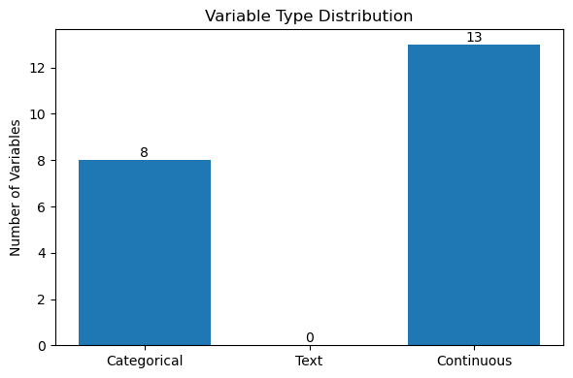
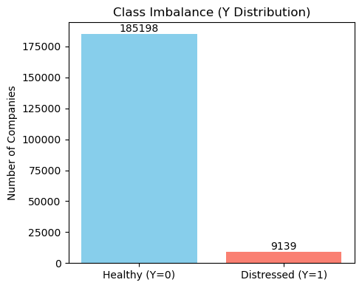
Data
Data
companies: 23033
features: 21
Class imbalance (Y=1 ratio): 0.0470
From Accounts to Alerts: EDA and Logistic Regression for Early Corporate Risk Prediction

Slide 5
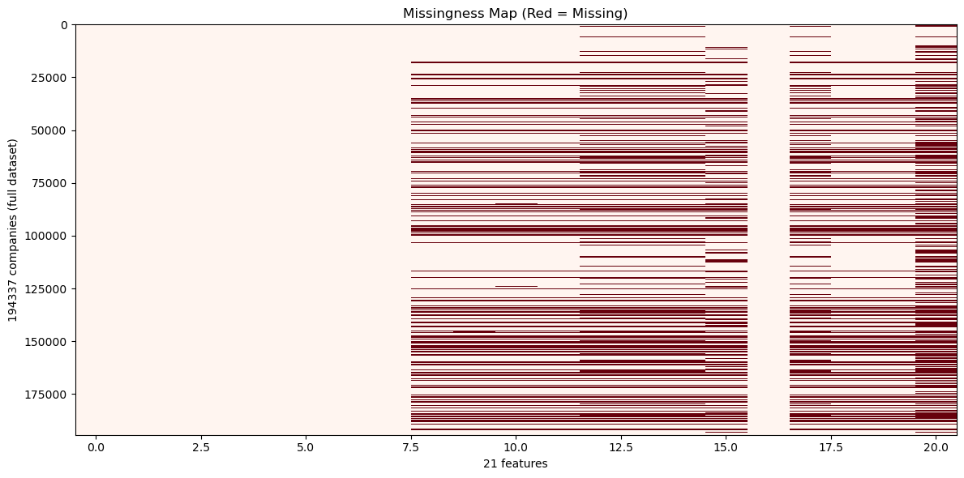
Data
Data
Average missing rate across all features: 18.17%
Impute: SIC2×year median (train-only); else overall train median
From Accounts to Alerts: EDA and Logistic Regression for Early Corporate Risk Prediction

Slide 6
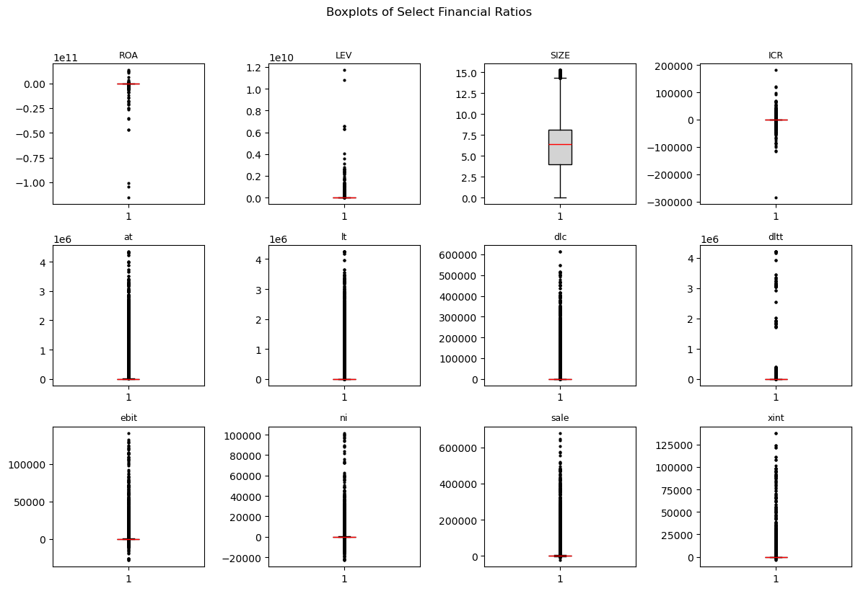
Data
Data
heavy-tailed and asymmetric distributions
From Accounts to Alerts: EDA and Logistic Regression for Early Corporate Risk Prediction

Slide 7
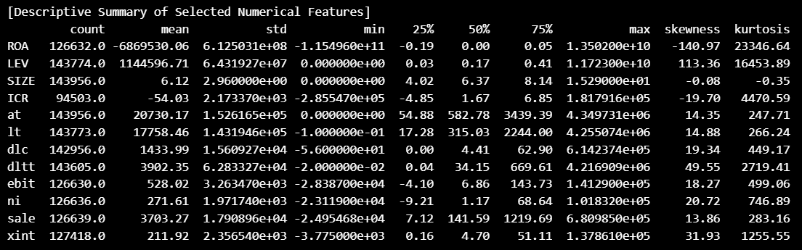
Data
Data
Most variables are highly skewed
Several variables exhibit extreme kurtosis (>10)
apply winsorization and log-transform before model estimation
From Accounts to Alerts: EDA and Logistic Regression for Early Corporate Risk Prediction

Slide 8
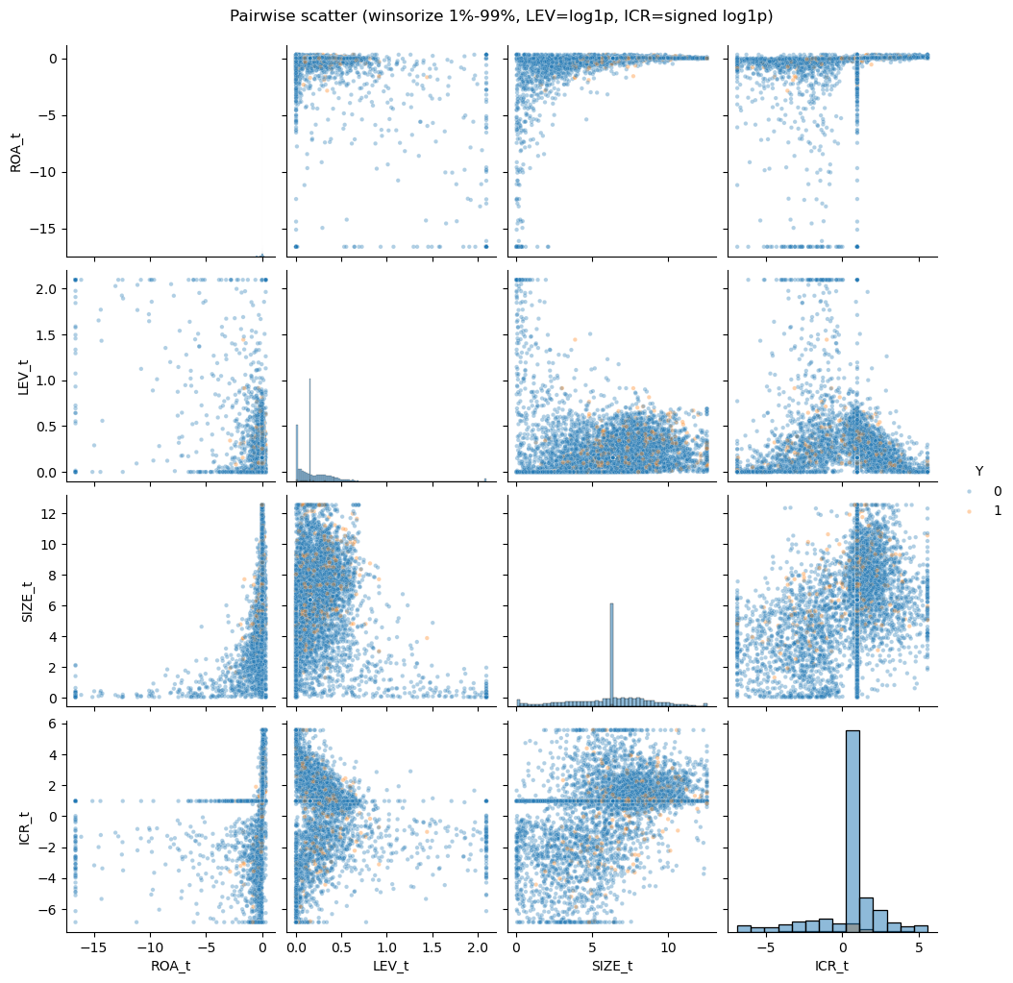
Data
Data
From Accounts to Alerts: EDA and Logistic Regression for Early Corporate Risk Prediction

Slide 9
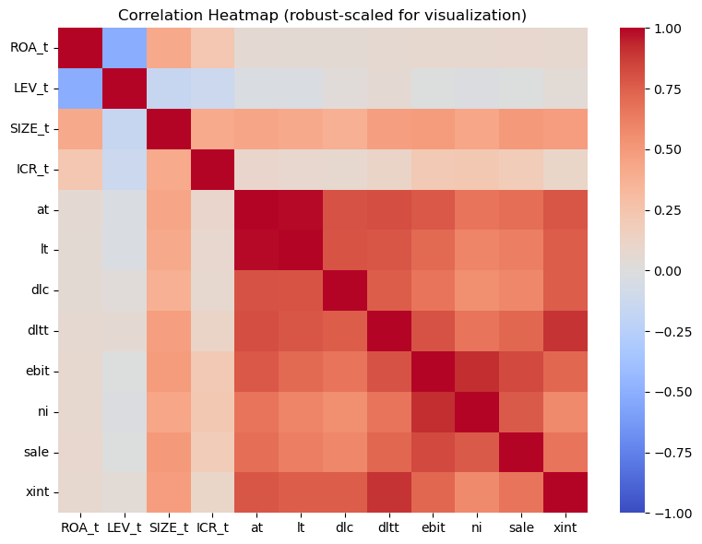
Data
Data
Positive correlations among size-related variables (at, lt, sale, ni)
ROA inversely related to LEV (higher leverage, lower profitability)
No major multicollinearity after data transformation
From Accounts to Alerts: EDA and Logistic Regression for Early Corporate Risk Prediction

Slide 10
Methodology
Overview
USA annual financial statements (2019–2024) + SEC Form 25 delisting labels
Label: Y=1 if a Form 25 becomes effective within 400 days after the financial statement date
Train: 2019–2023, Test: 2024
From Accounts to Alerts: EDA and Logistic Regression for Early Corporate Risk Prediction

Slide 11
Methodology
Benchmark Model
Penalized logistic regression (L1 / Lasso and L2 / Ridge variants)
Penalization reduces overfitting and selects relevant predictors
From Accounts to Alerts: EDA and Logistic Regression for Early Corporate Risk Prediction

Slide 12
Methodology
Class Imbalance Handling
Synthetic Minority Oversampling Technique (SMOTE) applied
Cost-sensitive weighting adjusts loss for rare default events
From Accounts to Alerts: EDA and Logistic Regression for Early Corporate Risk Prediction

Slide 13
Methodology
Design of Research
EDA and Feature Engineering: cleaning, transforming, visualizing ratios
Model Estimation: penalized logistic regression stratified by sector and time
Evaluation and Interpretation: performance metrics and SHAP analysis
From Accounts to Alerts: EDA and Logistic Regression for Early Corporate Risk Prediction

Slide 14
Methodology
Performance Measures
Discrimination: AUC / ROC, H-measure, and Precision–Recall curves
Calibration: Brier score and calibration plots
Threshold-based metrics: accuracy, sensitivity, specificity, F1-score
From Accounts to Alerts: EDA and Logistic Regression for Early Corporate Risk Prediction

Slide 15
From Accounts to Alerts: EDA and Logistic Regression for Early Corporate Risk Prediction
2025/10/13

